Slide 1
Chapter 15: Cases
2023

Slide 2
Chapter 15: Cases
Contents:
Introduction to cases
Cases with group by clause
Update clause with Cases.

Slide 3
CASE
The CASE statement is used to implement the logic where you want to set the value of one column depending upon the values in other columns.
The CASE Statement consists of at least one pair of WHEN and THEN statements. The WHEN statement specifies the condition to be tested. The THEN statement specifies the action if the WHEN condition returns TRUE.
The ELSE statement is optional and executes when none of the WHEN conditions return true.
The CASE statement ends with an END keyword.

Slide 4
Case
The CASE statement goes through conditions and return a value when the first condition is met (like an IF-THEN-ELSE statement):
So once a condition is true it will stop reading and return the result.
If no conditions are true it will return the value in the ELSE clause.
If there is no ELSE part and no conditions are true it returns NULL.

Slide 5
Case
CASE WHEN condition1 THEN result1 WHEN condition2 THEN result2 WHEN conditionN THEN resultN ELSE result END;
SELECT OrderID Quantity CASE WHEN Quantity > 30 THEN ‘The quantity is greater than 30’ WHEN Quantity = 30 THEN ‘The quantity is 30’ ELSE ‘The quantity is under 30’ END AS QuantityText FROM OrderDetails;
Notes:
Advanced
The CASE statement goes through conditions and returns a value when the first condition is met (like an IF-THEN-ELSE statement). So once a condition is true it will stop reading and return the result. If no conditions are true it returns the value in the ELSE clause.
If there is no ELSE part and no conditions are true it returns
More:
SELECT CustomerName City Country FROM Customers ORDER BY (CASE WHEN City IS NULL THEN Country ELSE City END); NULL.
/*
Create a report showing the customer ID and company name
employee id firstname and lastname and the order id
and a conditional column called "Shipped" that displays "On Time"
if the order was shipped on time and "Late" if the order was shipped late.
*/
SELECT c.CustomerID c.CompanyName e.EmployeeID e.FirstName e.LastName OrderID
(CASE
WHEN ShippedDate < RequiredDate
THEN On Time
ELSE Late
END) AS Shipped
FROM Orders o
JOIN Employees e ON (e.EmployeeID = o.EmployeeID)
JOIN Customers c ON (c.CustomerID = o.CustomerID)
ORDER BY Shipped;
Select
count(ID) as ItemsCount
sum( case
when PriceRating = Expensive then 1
else 0
End )
as ExpensiveItemsCount
From ItemSales
Result:
ItemsCount ExpensiveItemsCount
5 3

Slide 6
Case
SELECT
CASE
WHEN score < 70 THEN failed
WHEN score BETWEEN 70 AND 80 THEN passed
WHEN score BETWEEN 81 AND 90 THEN very good
ELSE outstanding
END AS performance
FROM test_scores;
SELECT
CASE grade
WHEN A THEN ‘Excellent’
WHEN B THEN ‘Good’
WHEN C THEN ‘Needs Improvement’
ELSE ‘Failed’
END AS ‘grade_interpretation’
FROM grades;

Slide 7
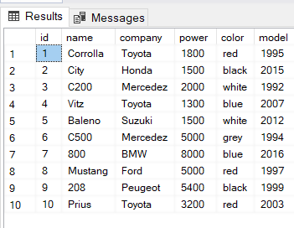
case
SELECT name model
CASE
WHEN model > 2010 THEN ‘New’
WHEN model > 2000 THEN ‘Average’
ELSE ‘Old’
END AS condition
FROM Cars

Slide 8
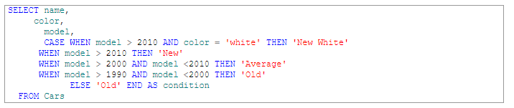
case

Slide 9
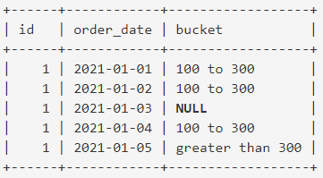
SELECT OrderID Quantity
CASE
WHEN Quantity > 30 THEN "The quantity is greater than 30"
WHEN Quantity = 30 THEN "The quantity is 30"
ELSE "The quantity is under 30"
END
FROM OrderDetails;
select id order_date
case when amount<100 then “less than 100”
when amount>100 and amount<300 then “100 to 300”
when amount>300 then “greater than 300”
end as bucket
from sales;

Slide 10
SELECT
SUM(CASE WHEN OrderStatus = ‘Success’ THEN 1 ELSE 0 END) AS Success Count
SUM(CASE WHEN OrderStatus = ‘On Hold’ THEN 1 ELSE 0 END) AS Hold Count
SUM(CASE WHEN OrderStatus = ‘In Process’ THEN 1 ELSE 0 END) AS Processing
SUM(CASE WHEN OrderStatus = ‘Shipped’ THEN 1 ELSE 0 END) AS Shipping count
SUM(CASE WHEN OrderStatus = ‘Cancelled’ THEN 1 ELSE 0 END) AS Cancellation Count
COUNT(*) AS Sum Total
FROM
Orders;

Slide 11
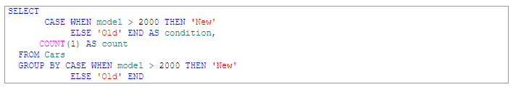

Case (with group by)
Notes:
If we want to count the number of new (model number greater than 2000) and old (model number less than 2000) vehicles we can use the GROUP BY clause with the CASE statement as follows:

Slide 12
Case (with Update)
Update tbl
Set Grade =
Case
When score >=90 then A+
When score >=80 then A
When score >=70 then B
Else Fail
End

Slide 13
Case / Joins
1. Create a report showing the customers, first name and last name a "NumOrders" column with a count of the orders taken and a conditional column called "Shipped" that displays "On Time" if the order shipped on time and "Late" if the order shipped late.
2. Group records by contact first name and last name and then by the "Shipped" status. Order by employee last name then by the first name and then by descending by the number of orders.
3. Use the simple CASE expression to create the work anniversaries column for the employees anniversaries starting from 2 to 5 years old and for everybody hired before the year 2000 show a status “'Hired before 2000”
4. Create the column to evaluate the salary of the employees if the salary is less than 3000 then the salary should be labelled as “Low”. If the salary is between 3000 and 5000 then it should be labelled as “average”. When the salary is greater than 5000 then it is “High”
L&D Shop, Company
Notes:
SELECT e.contactFirstName, e.contactLastName, COUNT(o.OrderNumber) As NumOrders,
(CASE
WHEN o.ShippedDate < o.RequiredDate
THEN 'On Time'
ELSE 'Late'
END)
AS Shipped
FROM Customers e
JOIN Orders o ON (e.customerNumber = o.customerNumber)
GROUP BY e.contactFirstName, e.contactLastName ,
(CASE
WHEN o.ShippedDate < o.RequiredDate
THEN 'On Time'
ELSE 'Late'
END)
ORDER BY e.contactFirstName, e.contactLastName , NumOrders DESC;
3
SELECT first_name, last_name,hire_date,
CASE (2000 - YEAR(hire_date))
WHEN 2 THEN ‘2 years'
WHEN 3 THEN '3 years'
WHEN 4 THEN '4 years'
WHEN 5 THEN '5 years'
Else 'Hired before 2000'
END anniversary
FROM employees
ORDER BY first_name;
4. select salary,
case when salary<3000 then 'low'
when salary between 3000 and 5000 then 'Average'
when salary>5000 then 'high'
end Salary_status
from Employees

